Slide 1

Visualizing Carbon Footprints Across Sectors Using Power BI

Slide 2

Learning Objectives
To analyze and visualize carbon emissions data across
various sectors, including transportation, energy,
agriculture, industry, uncover insights that
and residential. The goal is to can support climate-conscious
GOAL
decisions and promote sustainability through data-
driven storytelling.
Github link: https://github.com/balaji0901/powerbi.git

Slide 3
Tools and Technology used
Microsoft Power BI
Excel / CSV datasets
Data Cleaning & Transformation (Power Query)
DAX (Data Analysis Expressions)
AI-powered visualizations (Power BI AI Insights)

Slide 4
Methodology
1. Data Acquisition
Publicly available datasets related to carbon emissions were sourced from platforms like Our World in Data, World
Data Modeling
Established relationships between tables (e.g., emissions data and
Insight Generation
From the visualizations, the following analyses were performed:
Identified top-emitting sectors and
countries
Assessed the impact of economic growth on carbon footprints
Observed emission trends before and after policy changes or global events
region metadata)
Bank, and IEA. These datasets included: _{•Used DAX (Data Analysis}
Annual carbon emissions by sector (e.g., energy, transport, industry, agriculture)
Country-wise and global emission statistics
Time-series data from past decades
Expressions) to create calculated columns and measures
Dashboard Development Created a series of interactive and dynamic dashboards:
Time-series charts to show emission trends
Data Cleaning and Transformation
Using Power BI's Power Query Editor:
Cleaned raw data by removing
missing or duplicate entries
Filtered for relevant years, sectors, and countries
6. Reporting and Presentation
Summarized key takeaways in an
Sector comparison visuals (bar, pie, executive-style dashboard
and stacked column charts)
Map visualizations to display
emissions geographically
Used storytelling to present findings and emphasize the importance of data in promoting environmental awareness

Slide 5
Problem Statement:
With growing concerns about climate change and global warming, understanding and reducing carbon emissions have become a critical global priority. However, the complexity and volume of emissions data across various sectors—such as energy, transportation, agriculture, and industry— make it difficult for stakeholders to derive actionable insights.
There is a lack of accessible, interactive, and sector-specific visualization tools that can help policymakers, researchers, and the general public easily interpret carbon footprint data. Without clear insights into which sectors contribute the most to emissions and how these trends vary across regions and over time, designing effective strategies for sustainability becomes challenging.
This project aims to bridge that gap by creating interactive dashboards using Power BI to:
Analyze carbon emissions across sectors and regions,
Identify high-impact areas for emission reduction,
Empower decision-makers with data-driven insights for climate action.

Slide 6
Solution:
To address the lack of accessible and insightful carbon emissions analysis, this project uses Power BI to create interactive dashboards that simplify complex emissions data across sectors and regions.
By integrating data from reliable sources and transforming it into clear visualizations, the solution:
Highlights sector-wise and region-wise emission trends
Enables easy comparison over time
Helps identify high-impact areas for reduction
This empowers decision-makers with actionable insights to support effective climate strategies.

Slide 7

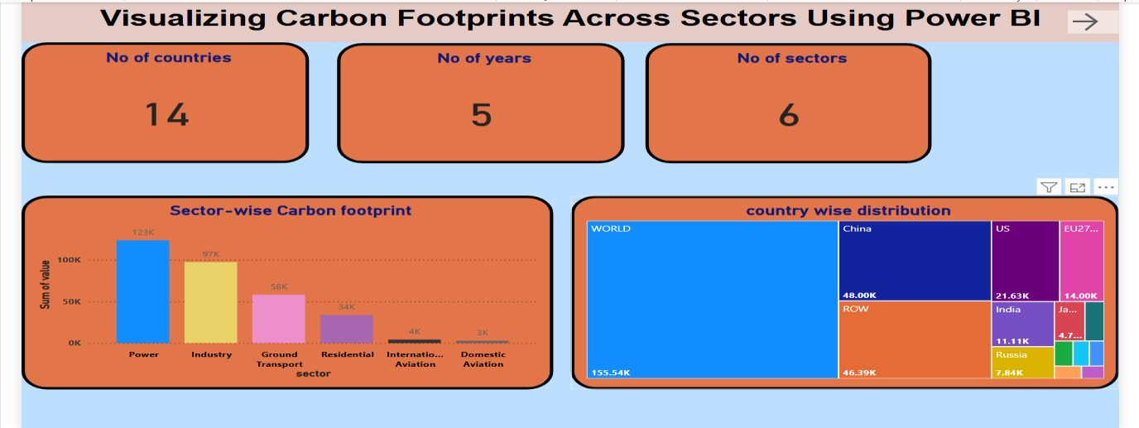
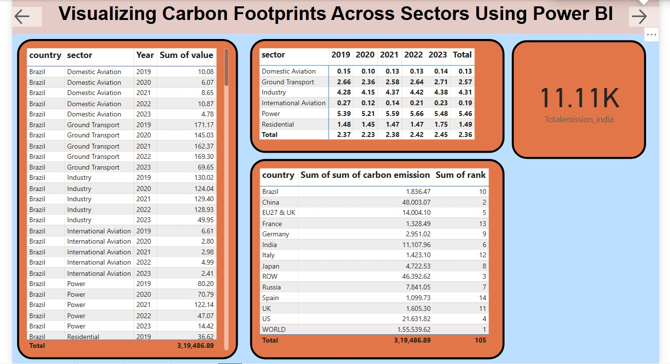
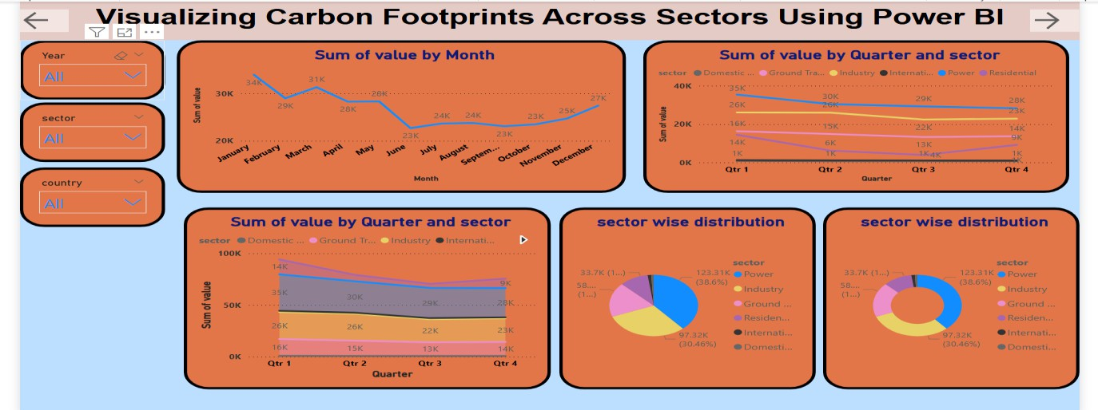
Screenshot of Output:
Page 1:
Page 3:
Page 2:

Slide 8
Conclusion:
This project successfully demonstrates how data visualization can play a vital role in understanding and addressing environmental challenges. By leveraging Power BI, we transformed complex carbon emission datasets into meaningful, interactive dashboards that provide valuable insights into sector- wise and region-wise carbon footprints.
Through this analysis, we identified key emission-contributing sectors, observed patterns and trends over time, and highlighted regions with the highest impact. The project not only improved data literacy around climate issues but also emphasized the importance of informed, data-driven decision- making for sustainable development.
Overall, this initiative contributes to the broader goal of climate awareness by making environmental data more accessible and actionable. It reinforces how technology, when combined with environmental science, can support global efforts toward carbon neutrality and a greener future.

